Slide 1

The County’s Responsibility for the Poor
Jefferson
Educational
Society
March 12, 2020
1706 to Present
From
Outdoor Relief,
to Shame,
to Almshouses,
to separate Institutional Care for children and the insane
to Community Based Programs

Slide 2
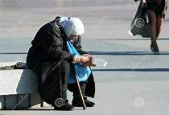
Who are the poor?
Those without the physical, mental and economic means to survive
Children without caregivers
The severely physically handicapped
Those with significant debilitating mental illness
Those with alcohol and drug addictions
Elderly unable to care for themselves
Mayor Joe Schember just announced that there are at least 1,000 people living on the streets of Erie

Slide 3
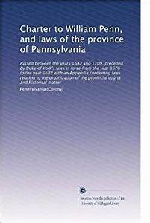
Early History in PA of Caring for the Poor
Prior to the 1600s care of the poor was an ecclesiastical responsibility
1600 Duke of York’s Laws in England recognized government’s role in caring for the poor
1640 Duke of York’s Laws transferred from England to New York & then PA
Proprietary Government of William Penn established in 1682 was built on the Duke of York’s Laws
1706 PA adopted first general poor relief act which required the appointed justices of each county to select two or more overseers of the poor in the county or in the township to be responsible to the justices for the care of the poor
1706 the Poor in PA become County Responsibility
PA COUNTIES
1750
COUNTY | DATE EST.
Philadelphia | 1682
Lancaster | 1729
York | 1749
Cumberland | 1750

Slide 4
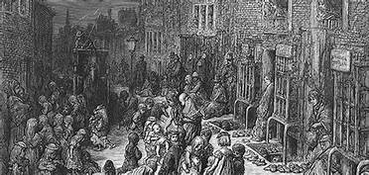
Who were the early settlers in PA? England exported about 500,000 English subjects between 1630 and 1642 about ½ to North American colonies, most of them vagrants
England’s population grew dramatically in the second half of 16th century, increasing by a third between 1560 and 1600, from 3 to 4 million.
Population growth was concentrated in London where rural people sought employment
Enclosure, poor harvests, and a breakdown in distribution of food produced acute grain shortages and migration to cities where people lived on the streets
Growing desire to rid England of “lewd vagrants”
Many argued that England’s surplus population could be exported to colonies, preventing unrest and poverty
POPULATION GROWTH
OF ENGLAND
1490 | 2,140,000 | +12.6%
1522 | 2,350,000 | +9.8%
1541 | 2,830,000 | +20.4%
1560 | 3,200,000 | +13.1%
1600 | 4,110,000 | +28.4%
1650 | 5,310,000 | +29.2%

Slide 5
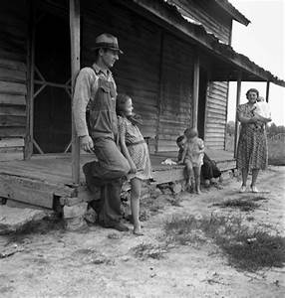
Who were the early settlers? The dissenters: The Puritans & The Quakers The outcasts: The Felons The Poor The Irish & Scots
1603 King James I ordered rogues, vagabonds, and beggars transported to parts beyond
1615 James I ordered English convicts under sentence of death to be sent to Virginia
1618 City of London spent about 500 pounds to transport 200 of its poor children to VA
1619 a joint stock company was formed to send young women to Virginia with passage to be paid by planters who selected them as wives
1620 Indentured servitude was created to facilitate the transplantation of England’s poor to the colonies
1622 Council for New England exported poor children ages 14 years and up from London to America
Between 1661 and 1700, 4,500 felons were transported to America
1663 Authorized shipment of Irish and Scottish rather than the English to New World
Source: Asylum for Mankind America 1607-1800

Slide 6
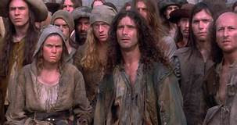
PA GENERAL SETTLEMENT ACT -- 1718 P
SHAMING
1718 PA General Settlement Act
Central purpose was to discourage poor from asking for relief, except as a last resort
Anyone belonging to a family which received aid was required to wear a large red or blue “P” on his right shoulder
Those who refused could be denied relief or sent to the local jail and forced to do hard labor
DESPITE THE FACT THAT BRITISH NORTH AMERICA WAS A DEATH TRAP RATHER THAN A LAND OF OPPORTUNITY.
Asylum for Mankind
p
p
p
p

Slide 7
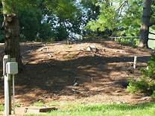
PA uses local administrative units, its counties and townships, to take care of the poor
The Poor Law of 1722
County Commissioners became the local administrative agency of PA
Counties continued to have responsibility for poor
The Poor Law of 1771
County Commissioners were authorized to collect Poor Tax
Moneys were to be used only for direct relief to persons unable to work or for providing employment
Outdoor Relief was favored:
Road work
Stump removal
Debris clearance
Counties (or Townships if counties did not exist) were authorized to elect three individuals who served as Directors of the Poor or Overseers of the Poor

Slide 8
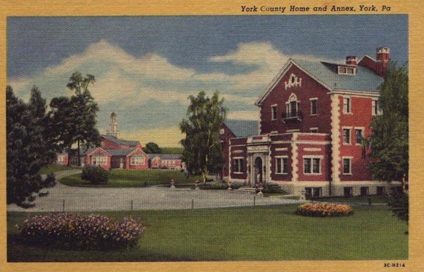
Almshouses become preferred way to take care of poor aka Poor Farms or County Homes
In PA almshouses (aka Poor Farms) became the chief way for counties to care for the poor
Housed insane, sick, orphans, aged and poor
Were initially self supporting
Farmed, raised vegetables, crops, chickens, and had orchards
Erie County did not have an almshouse until 1840
York almshouse built about 1800

Slide 9
1840 -- Erie County votes for Almshouse and is authorized to elect Directors of the Poor
State managed the care of the Poor through local Directors of the Poor
1825 State authorized Directors of the Poor to decide what type of aid to grant the poor of their district
1836 State laws made it the duty of the Directors of the Poor to provide work for any poor persons unable to find employment
1839 voters of Erie County turn down the construction of an almshouse
1840 State gave Erie County authority to hold another referendum for an almshouse, which passed
1840 State required Directors of Poor to be elected in Erie County
ERIE COUNTY OBTAINED ITS FIRST COMPLEMENT OF DIRECTORS OF THE POOR AFTER THE 1840 REFERENDUM
AFTER THE SUCCESSFUL REFERENDUM, ERIE COUNTY WAS RECOGNIZED AS A SINGLE POOR DISTRICT

Slide 10
JOHN H. WALKER Father of Erie County’s First Almshouse
Member of Pa General Assembly
Member of the Anti-Masonic Party
1832 sponsored an act obtaining 2,000 acres of State land in Mill Creek township
100 acres were to be reserved to Erie County for the erection of an almshouse
This was later increased to 118 acres
Other acreage provided to Erie Extension Canal
Land for almshouse selected from the 2,000 acres by 3 commissioners appointed by County Commissioners. The 3 commissioners were:
William Miles
George Moore
David McNair

Slide 11
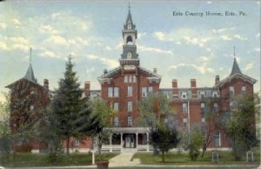
Located in vicinity of 23rd and Pittsburgh Ave. in what is now Millcreek Township
Stood 4 stories tall, measuring 190 ft. by 57 ft., with a rear wing of 3 stories measuring 84 ft. by 32.5 ft.
Constructed of brick, had 3 towers
Built to accommodate population of 270 poor, 135 of each sex
In 1840, the building cost county $1,065.00, which was levied from taxes
Opened in 1841
Erie County’s First Almshouse

Slide 12

Directors of the Poor were elected in Erie County from 1840 to 1937 They were responsible for managing the poor farm
Beginning in 1840, 3 Directors of the Poor were elected county-wide for 3 year terms
Directors had responsibility for
Administering the almshouse, a self sufficient farm
Appointing staff, including an attorney
Receiving and managing poor-assistance dollars from the State
First inmates to come to the almshouse were referred to as paupers
They included
2 single men
1 blind woman
1 mother with 4 children

Slide 13
ELECTED DIRECTORS OF THE POOR
YEAR | NAME | AREA
1840-41 | James Benson | Waterford Twp.
1840-1842 | Thomas Miller | Springfield
1840-1843 | George Walker | Harbor Creek
1841-1844 | Conrad Brown | Mill Creek
1842-1845 | John Evans | Mill Creek
1843-1846 | James Anderson | Waterford
1844-1847 | David Kennedy | Erie
1845-1848 | Curtis Heidler | Fairview
1846-1849 | William Bracken | LeBoeuf
ELECTED DIRECTORS OF THE POOR
YEAR | NAME | AREA
1847-1850 | David Sterrett | McKean
1848-1851 | David Kennedy | Erie
1849-1852 | George Fritts | Waterford Twp.
1850-1853 | Melville Kelso | Fairview
1851-1854 | William McNair | Mill Creek
1852-1955 | John Parmeter | McKean
1853-1856 | John Hay | Girard
1854-1857 | George Brecht | Mill Creek
1855-1858 | Samuel Keefer | Erie
ELECTED DIRECTORS OF THE POOR
YEAR | NAME | AREA
1856-1859 | John Spaulding | Springfield
1856-1857 | John Hay | Girard
1857-1860 | Alexander Nicholson | Fairview
1857-1859 | William Bracken | LeBoeuf
1858-1861 | Thomas Stewart | Erie
1859-1862 | William Bracken | LeBoeuf
1862-1865 | Archibald Duncan | North East
1863-1866 | Thomas Willis | Mill Creek
1863-1867 | Thomas Stewart | Erie

Slide 14
ELECTED DIRECTORS OF THE POOR
YEAR | NAME | AREA
1865-1868 | Andrew Thompson | Union Twp.
1866-1869 | Thomas Willis | Mill Creek
1867-1870 | Jacob Hanson | Erie
1868-1870 | Andrew Thompson | Union Twp.
1870 | Steven Beavis | Corry
1870 | Louis Olds | Erie
1870 | William Eaton | Fairview
1873 | Michael Henry | Merrick Chamberlain
1874 | James Dunn | McKean
ELECTED DIRECTORS OF THE POOR
YEAR | NAME | AREA
1875 | Michael Henry | Erie
1876 | John Kincaid | Wayne
1877 | Seymour Washburne | McKean
1878 | George Riblet | Erie
1879 | Jefferson Triscuit | Union
1880 | John Zuck | Mill Creek
1881 | Joseph Henderson | Erie
1882 | Jefferson Triscuit | Union
1883 | O.J. McAllister | Wattsburg
ELECTED DIRECTORS OF THE POOR
YEAR | NAME | AREA
1884 | F. Willis | Fairview
1885 | O. J. McAllister | Wattsburg
1886 | Henry Dunn | Erie
1887 | Daniel Roberts | Elk Creek
1888 | Benj. Riblet | Harbor Creek
1889 | Henry Dunn | Erie
1890 | Wm. Hopkins | Girard
1891 | Benj. Riblet | Harborcreek
1892 | Joseph Blenner | Erie
Under act of Assembly, a full board was elected in 1870

Slide 15

Increasing Expenses Lead To Another Alternative
CONTROLLING EXPENSES
Throughout the 19th century almshouses were a last resort for those who were poor, disabled, and elderly
Many residents experienced mistreatment, destitution, and inhumanity
As almshouses continued into the 19th century, activists such as Dorothea Dix fought for the removal of children, the mentally ill, and the developmentally disabled from all almshouses and to increase the number of institutions, hospitals, and asylums for those groups to reside in
1874
State forbade Directors of the Poor to have a self-interest in a contract concerning the poor
All contracts for more than $500.00 must be in writing and available for review
1879
State gave Directors authority to withdraw relief from anyone refusing to go to the almshouse
YEAR | NUMBER OF POOR | COST
1860 | 107 | 7,629.00
1880 | 221 | 28,659.00
1890 | 183 | 33,000.00
Source: Nelson’s Biographical Dictionary, 147 & 373

Slide 16
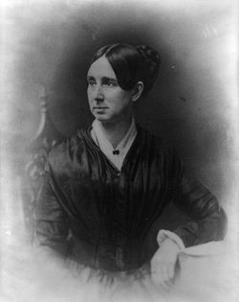
Dorothea Dix
Dorothea Lynde Dix (April 4, 1802 – July 17, 1887)
An American advocate on behalf of the indigent mentally ill who, through a vigorous and sustained program of lobbying state legislatures and the United States Congress, created the first generation of American mental asylums
During the Civil War, Dix served as a Superintendent of Army Nurses
Warren State Hospital in Warren, PA, for the mentally impaired was opened in 1880

Slide 17
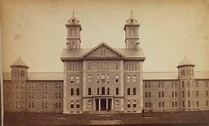
State creates Warren State Hospital for treatment of insane in NW PA
1873
Approved August 1873, the Governor of PA was authorized to appoint 3 commissioners to select a site and build a hospital for the insane of the Northwestern district of the state (Erie, Crawford, Mercer, Venango, Warren, Clarion Counties)
1880
Warren State Hospital opened
1885
Male insane from Mill Creek Almshouse were transferred to Warren State Hospital

Slide 18
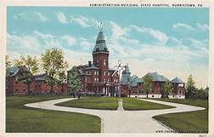
State Creates Polk Center 1883 State act made it unlawful to keep children ages 2 to 15 in an almshouse for longer than 60 days unless the child was an epileptic, paralytic, unteachable, deformed and incapable of working
1917
State permits Directors of Poor to enter contract with institutions for the care of persons with hearing impairment and blindness
1923
Mental Health Act dictates that persons in need of treatment and care in a mental hospital be detained in almshouse only in an emergency
Expenses for insane paupers in public institution was to be joint responsibility of the State, the county and the Poor District
1893
The State established Polk Center, an institution for developmentally challenged children of Western Pennsylvania and authorized the Governor to appoint five commissioners to select a site and build an institution
1897
Polk Center for “feeble minded” opened

Slide 19
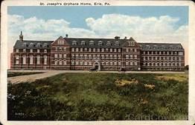
The Importance of Philanthropic Organizations Continues
1881
W. L. Scott, J. F. Downing and W.S. Brown organized the Charity Society
Purpose was to coordinate care provided by Poor District and charitable agencies
Charity Society was concerned with overlapping relief
Mission: promote the welfare of the po0r through the inculcation of self-reliance
Charity Society provided employment counselors to help direct poor to employment
SOME EARLY PRIVATE PHILANTHROPIC CARE CENTERS
Ball Home
B’nai B’rith Home for Children
City Mission Home
Florence Crittenton Home
Erie Infants Home & Hospital
Lutheran Home for the Aged
Our Lady of Peace House
PA Soldiers and Sailors Home
Sarah Reed Home
Sarah Reed Home for Children
St. Joseph’s Home for Children
St. Mary’s Home for the Aged
Salvation Army Home
Source: 1939 Erie City Directory, 1225.

Slide 20
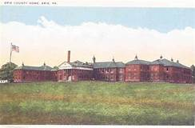
Erie County Builds New Almshouse in Girard Twp.
1919
Erie Directors of the Poor purchased 236 highly productive acres called the Dobler Estate in Girard Twp.
1924
Construction of the $700,000 new almshouse was completed and first inmates were transferred
The building was the largest project at that time undertaken by the County
Designed to be self sustaining
From 1923 to 1933 PA disbursement for poor relief doubled.
While almshouse expenditures remained about the same per patient, there were more people who needed care

Slide 21
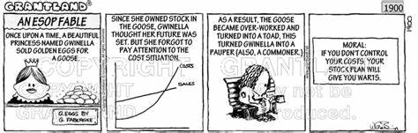
PA and Counties Attempt to Control Escalating Costs
1925
Department of Welfare required all purchases of land and all plans for buildings to be used for the poor be approved by the Department of Welfare
1933
79.5% of poor relief funds coming from the State or Federal government
By 1900
By the beginning of the 20th century the County almshouse expenditures had become the largest single County expense
From 1923 to 1933
PA disbursements for poor relief doubled
By 1924
State was picking up most of the operational costs of almshouses of PA
1929
GREAT DEPRESSION BEGINS

Slide 22
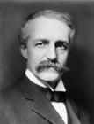
Governor Gifford Pinchot and the Depression
Served as Governor from 1923-1927 and 1931-1935
Believed that federal government was the only entity strong enough to meet the calamities of the Great Depression
1931 First Talbot Act
Allocated $10,000,000 to the Department of Welfare to be distributed to County Poor Districts
Must be used by Directors of the Poor for food, clothing, food and shelter
Funds could not be given directly to poor
1932 Second Talbot Act
Allocated $12,000,000 in unemployment aid
Paid for by a 1% sales tax
Created State Emergency Relief Boards in every county to distribute funds usually through Poor Districts
Took over 20,000 miles of rural roads from townships, using unemployed and rural poor to pave the roads

Slide 23
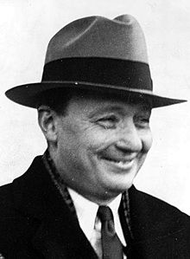
George H. Earle III Governor of PA 1935-1939
1937 County Institution District Law
Every county became an Institution District
County Commissioners became the County Institution District Board
Required counties to levy poor tax not to exceed 10 mills on every dollar of assessed evaluation
Prime responsibility was the maintenance of the county almshouses
1937 Public Assistance Law
Created Department of Public Assistance
Adopted uniform measures for the administration of relief in Pa
Created structure with County Boards of Assistance in every county
7 persons
Appointed by Gov.
3 year term
Required mixed party affiliation
Served without pay
1937: Public Assistance Law abolished the previous role of Poor Districts placed relief for the poor under state regulated and appointed County Boards of Assistance

Slide 24
1937 County Institution District Law Almshouses Regulated by the State
In same year 1937 State adopted County Institution District Law
Law made the County Commissioners the Institution District Board
The State set parameters for the County Commissioners as the Institutional District Board in charge of almshouses
County Commissioners could issue bonds and raise funds only for certain stipulated purposes such as the acquisition of real estate
All bond issues must have approval of the State
State had authority to inspect records of deaths, burials, physician records, financial transaction and other reports
State law continued to indicate that the chief duty of the Institution District Officers (County Commissioners) was to care for any dependent having legal residence in the county and all persons without legal residence until they could be taken back to their homes

Slide 25
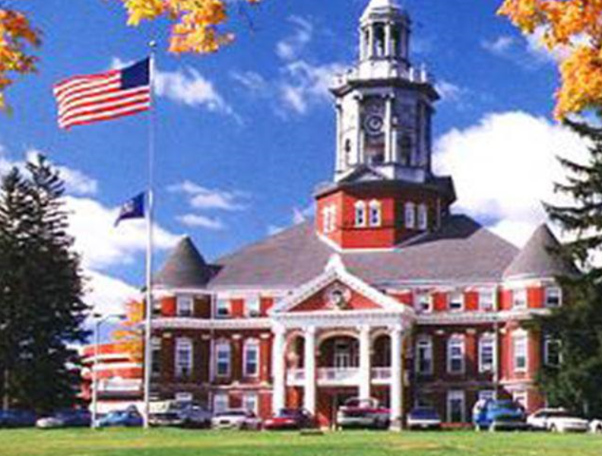
1938 State legislation makes special populations the State’s responsibility
Effective June 1941, State adopted legislation that required the State to assume all responsibility for the care of children, the insane, and assume responsibility for all mental hospitals owned by counties and other municipalities.
The legislation lifted Erie County’s economic responsibility for Erie County residents who were hospitalized in facilities such as Warren State Hospital and Polk Center
All Social Service assistance programs were placed under the authority of the State. The counties were not to have control over any phase of social service network. Social services became a wholly State operation under State control with counties as their administrative units
POLK CENTER ESTABLISHED 1897

Slide 26
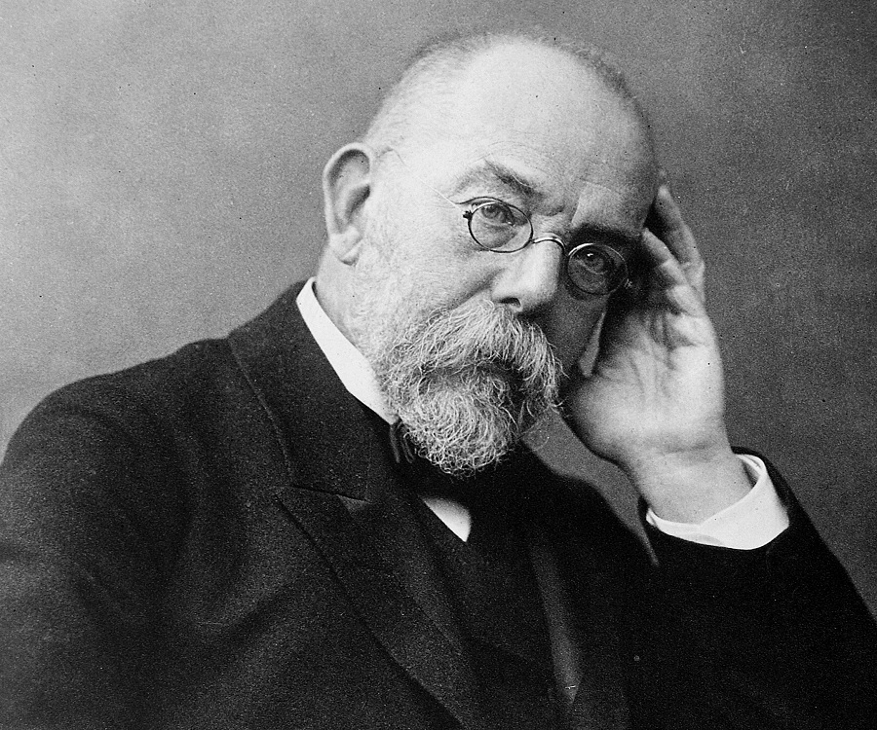

Erie County Tuberculosis Hospital
TUBERCULOSIS AT THE BEGINNING OF THE 20TH CENTURY
Robert Koch’s discovery, in 1882, of the bacilli that caused tuberculosis provided evidence that the disease was infectious
In his acceptance of his Nobel Prize in 1905, he alluded to the work of his colleague and a fellow bacteriologist, Carl Flügge, who had determined that bacilli in droplets from a cough could possibly transmit infection
With this information, the medical community knew that with concerted effort Tuberculosis could be eradicated
In Erie County tuberculosis became the chief concern of the local American Red Cross
Concerned citizens incorporated as the Erie County Society for the Prevention and Treatment of Tuberculosis
1915 State law permitted any county to appropriate as much as $10 a week to pay for the maintenance of an indigent person in any tuberculosis hospital established by the county
1921 State ordered that all tuberculosis facilities receiving state funds were to be operated by the County Commissioners
1922 referendum on Erie County ballot asked voters whether Erie County should establish a county hospital for the treatment of persons afflicted with tuberculosis to be paid for by 1 mill of taxes. Voters overwhelmingly approved the referendum
1938 Erie County’s 65 bed Tuberculosis Hospital was opened on land given to the County by Erie County Society for the Prevention of Tuberculosis

Slide 27
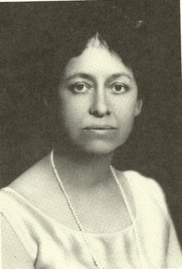
An Unsung Heroine: First Chair of the Erie County Tuberculosis Hospital Katherine Law
Katherine Law
Katherine, daughter of Stephen and Ella Kimball Law
Great-Great grand daughter of Samuel Hays, Burgess of Erie during the building of the Perry fleet
Katherine’s mother died when she was 2 and Katherine was sent to Massachusetts
Katherine eventually attended Women’s Medical College and graduated with MD in 1904
In 1909 returned to Erie and became involved in public health
Active in fighting Spanish Flu epidemic of 1918
1920 elected President of Erie Medical Society
Served as Chair of the Erie County Tuberculosis Hospital

Slide 28
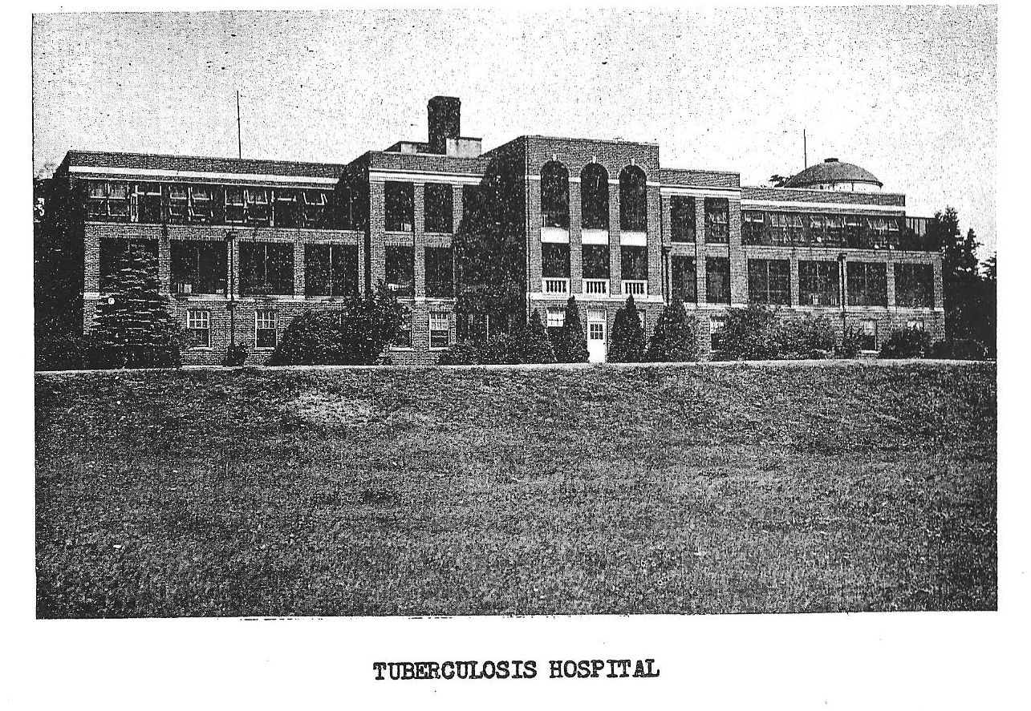
Erie County Tuberculosis Hospital Opened in 1938

Slide 29
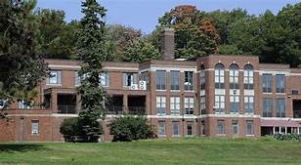

Tuberculosis. . to Long-Term Care . . . to Closure
1953 addition of a west wing to Tuberculosis Hospital was finished
1964 tuberculosis no longer a problem
1964 State reimbursement decreasing because it was paid per TB patient
1964 Erie County Home running out of room for growing aging population
1964 County Commissioners Louis Rzymek, Bill Hill, Fred Lamberton proposed merger of Erie County Home and Tuberculosis Hospital
1964 State approved the combined facility for reimbursement
2015 County closes Pleasant Ridge East
1940s Tuberculosis remained a health problem and admissions grew
1946 streptomycin became available

Slide 30
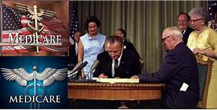
1965 Medicare and Medicaid Most Consequential Health Legislati0n in U.S. History
FEDERAL GOVERNMENT BECOMES CHIEF FUNDER FOR POOR

Slide 31
1960s and 1970s Deinstitutionalization
JFK sponsored the passage of the Community Mental Health Act, one of the most important laws that led to deinstitutionalization
The de-institutional movement continued to gain momentum during the Civil Rights Movement
The 1965 amendments to Social Security shifted about 50% of the mental health care costs from states to the federal government, motivating state governments to promote deinstitutionalization
The 1970s saw the founding of several advocacy groups for deinstitutionalization including Liberation of Mental Patients, Project Release, Insane Liberation Front, and the National Alliance on Mental Illness (NAMI)
The lawsuits these activist groups filed led to some key court rulings in the 1970s that increased the rights of patients
In 1973, a federal district court ruled in Souder v. Brennan that whenever patients in mental health institutions performed an activity that conferred an economic benefit to the institution, they had to be considered employees and paid the minimum wage required by the Fair Labor Standards Act of 1938.
In the 1975 ruling O'Connor v. Donaldson, the U.S. Supreme Court restricted the rights of states to incarcerate someone who was not violent.
This was followed up with the 1978 ruling Addington v. Texas, further restricting states from confining anyone involuntarily for mental illness.
Community Mental Health
Anti-psychotic medicines
Foster parent program
Work Release
Assisted Housing
In 1950s 500,000 were in mental health h0spitals, by 1970 there were over 100,000

Slide 32
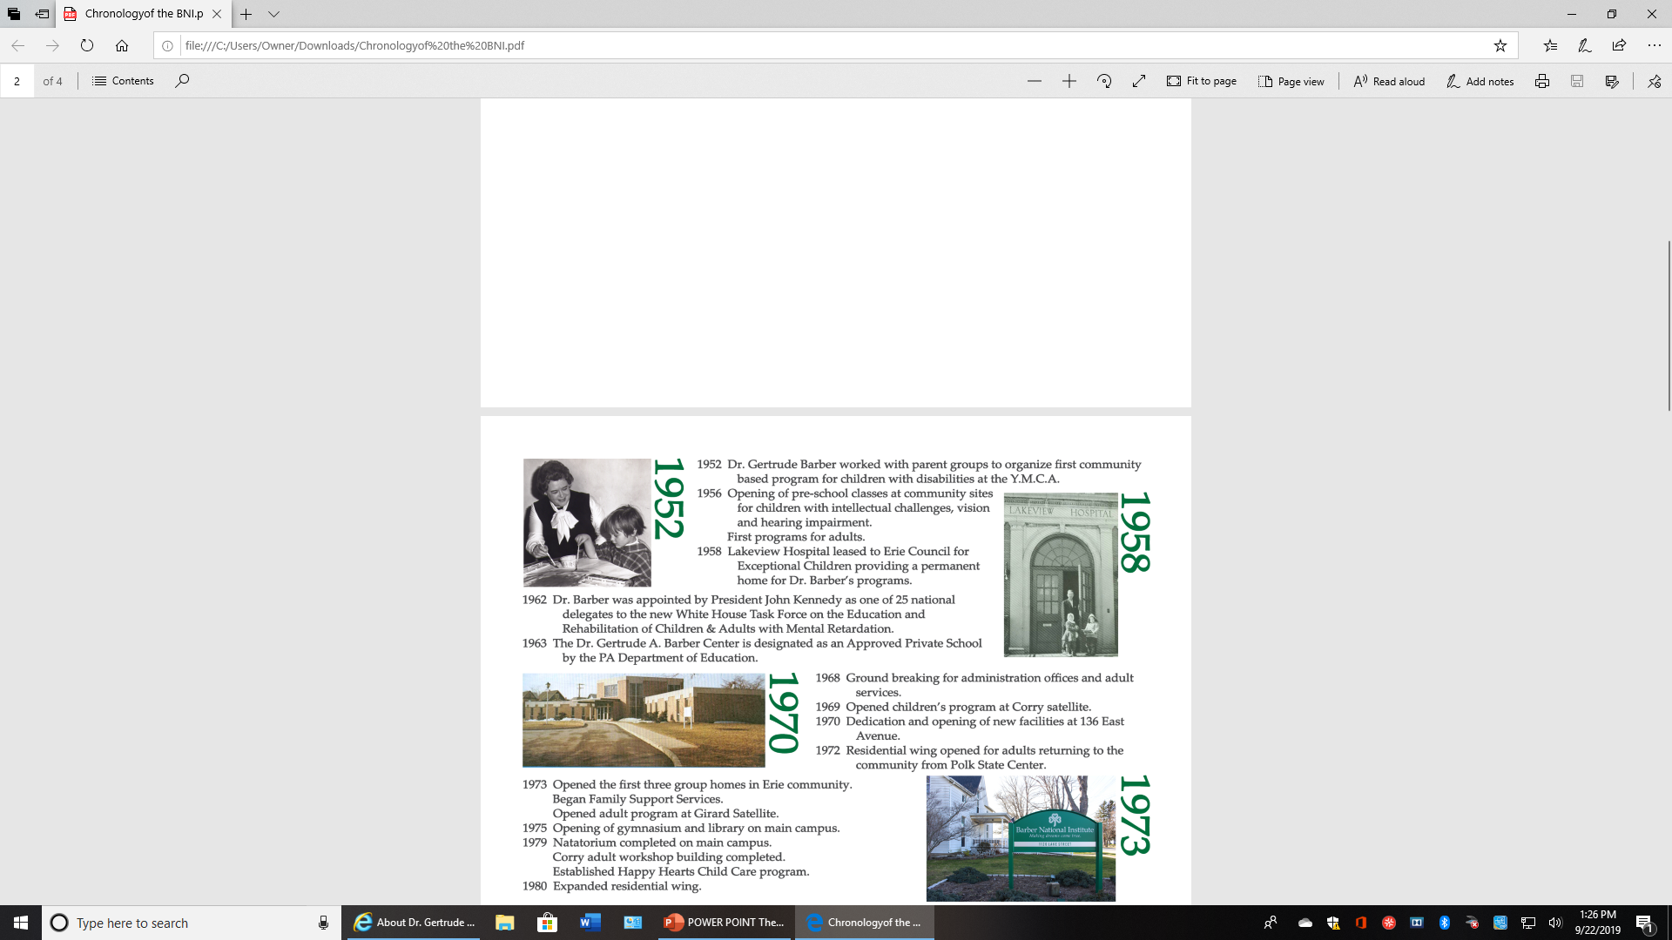
Community Based Programs Example: The Barber Center

Slide 33
Community Based Programs Example: Stairways Behavioral Health
Our Mission
Stairways Behavioral Health assists persons with mental health care needs at any stage of life in their recovery by providing comprehensive rehabilitation, treatment and supports essential for living, working, learning and participating fully in the community.

Slide 34

Community Based Programs: Example: Erie Homes for Children and Adults
EHCA provides daily residential and community programming to over 400 individuals with disabilities every day in Erie, Crawford, and Venango counties.
founded in 1912, the agency
has 18 group homes for people with intellectual and physical disabilities.
has six community programs which offer opportunities and support services for individuals with disabilities who reside with family members or on their own.

Slide 35
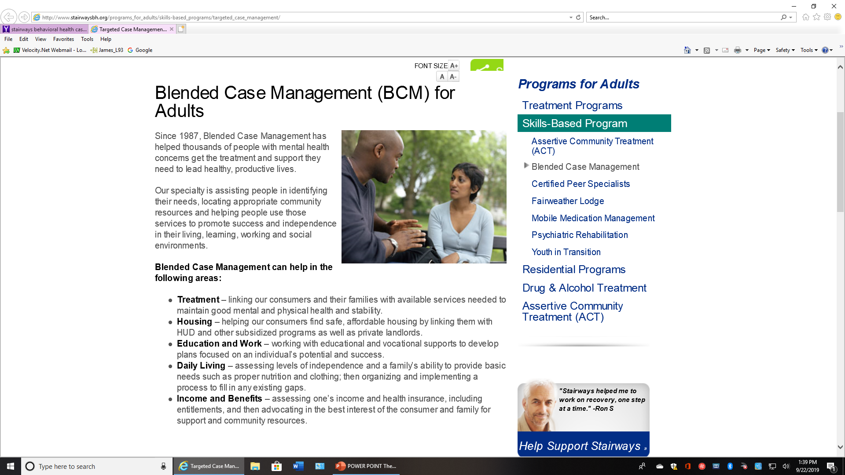
CASE MANAGEMENT

Slide 36
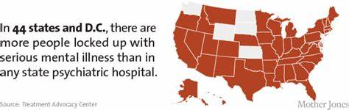
A consequence of community based care: Increased Incarceration
According to a report by the Treatment Advocacy Center, American prisons and jails housed an estimated 356,268 inmates with severe mental illness in 2012—on par with the population of Anchorage, Alaska, or Trenton, New Jersey. That figure is more than 10 times the number of mentally ill patients in state psychiatric hospitals in the same year—about 35,000 people.

Slide 37
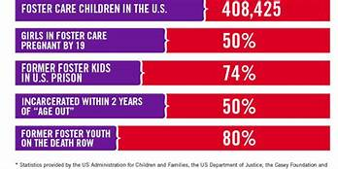
Some Problems with Foster Care:

Slide 38
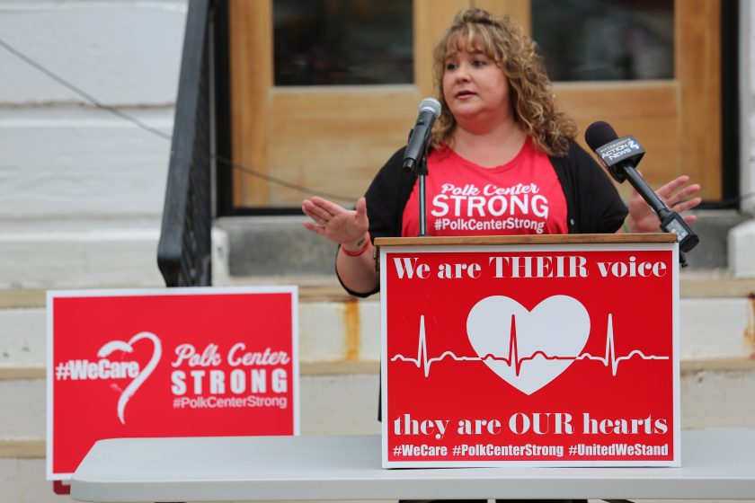
The Closing of Polk Center
State announced its intention to close Polk within 3 years
Done by Executive Order of Governor Thomas Wolf
Agreement of Board with members including John Barber CEO of the Barber Center and Chuck Walczak CEO of Erie Homes for Children and Adults
194 current residents will be placed in community based care

Slide 39

FOOD ASSISTANCE CHARITIES ERIE COUNTY
Community of Caring
Emmaus Soup Kitchen
Erie City Mission
Holy Trinity Lutheran Church
St. Paul’s R.C. Church
Metro-Erie Meals on Wheels
GECAC Meal on Wheels
Community of Caring Food Bank
Erie City Mission – Family Care Center
Erie Center City Outreach Food Bank
Emmaus Food Pantry Food Bank
Glenwood United Methodist Church
Martin Luther King Center Food Bank
Salvation Army – Food Bank
St. John’s Episcopal Church – Food Pantry
St. Patrick’s Church – Food Bank
St. Peter’s Cathedral – Food Bank
Holy Trinity Lutheran Church – Food Bank
SHELTERS IN ERIE COUNTY
Hope House for Families
Mercy Center for Women
House of Healing for Women & Children
The Community of Caring
St. Martin Center, Inc.
SafeNet
Emergency Community Shelter Service Erie
Housing Authority of County of Erie
Erie City Housing Authority
Liberty House Erie
Ellen Curry Foundation
Bayfront NATO, Inc.
Erie United Methodist Alliance
Care of the poor not only responsibility of government but remains the mission of philanthropic agencies

Slide 40
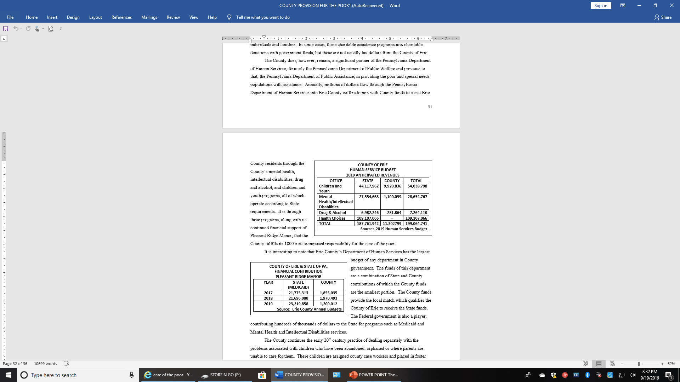
Medicaid (Health Choices) (State and Federal Funds) and County Assistance
Medicaid (Health Choices), a state administered and state/federal funded program, is the largest source of funding of programs for the poor including housing assistance, food assistance, and long-term care in facilities such as Pleasant Ridge

Slide 41


County’s Roll in Providing for the Poor The Debate Continues . . .
The County remains a significant partner of the Pennsylvania Department of Human Services in providing special needs populations with assistance
Over 12 million dollars annually are collected from Erie County tax payers in property taxes that go to support the poor
It is also a partner with the Federal Government which contributes to Medicaid and has seen assistance to the poor change from Temporary Assistance to Needy Families to the Work Opportunity Act
The Human Services budget is the largest part of the Erie County budget

